Slide 1
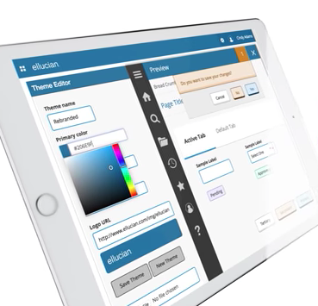
Banner 9 Training
New Look & New Features

Slide 2
Purpose of the Training
Introduce & review Banner 9 upgrades and new features
Navigate Banner 9
Effective use: daily operations and student services
Customize for your needs

Slide 3
Banner 9 Agenda
Day One
Intro to Banner 9: features, functions, format, options, myBanner menu
Day Two
Functional areas of Banner 9
Day Three
Integration of Functional areas of Banner 9

Slide 4
Banner 9 - What’s Different?
New look & feel - reorganization
Application Navigator & Main Menu
Search: multi-level, ‘Google like’
Navigation tools: updates to keyboard shortcuts
User Interface: web controls (Oracle/Java phase out)
Browser compatibility: Chrome, Firefox, Microsoft Edge
Banner forms – called Pages – grouped based on business processes they support
Improved accessibility
Notes:
Banner is an enterprise resource planning ERP system. Providing access to related information for planning and decision-making purposes from scheduling classes to issuing paychecks.
Group-based pages: example all forms related to check pringint will be identified and migrated to Banner 9 at one time.

Slide 5
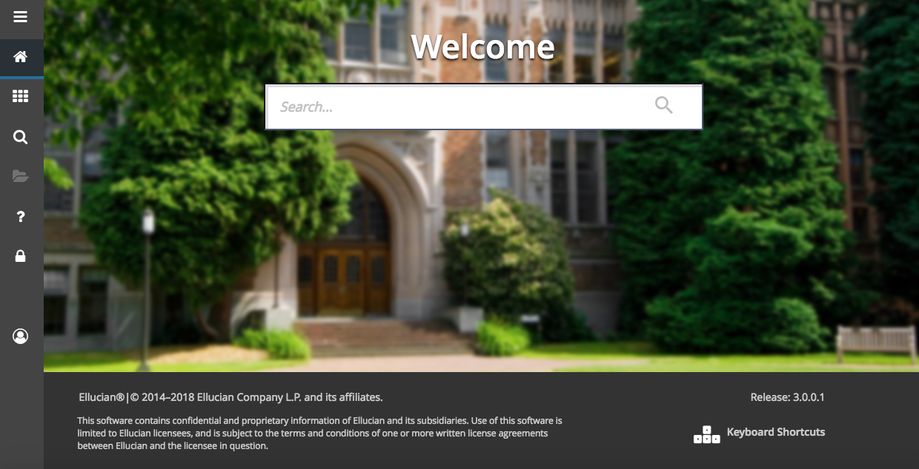
Application Navigator Access Banner Administrative Applications
Notes:
Application Navigator – is the landing page and home link.
Menu icon (CTRL+M) – The Menu icon is located in the upper left corner of the application. Click on this icon to open the Banner Menu. Find the page you are interested in opening. Select the desired entry and click Enter. The Menu icon will also allow you to open the My Banner menu which will allow you to create a personal list of pages that you use regularly. See the appendix for directions regarding how to set up My Banner.
Search icon (CTRL+Shift+Y) – The Search icon is located in the upper left corner, just to the right of the Menu icon. Click on this icon to open the Search window. You can then enter either the descriptive name of the page or the Banner acronym for the page.
Recently Opened icon (CTRL+Y) – The Recently Opened icon is located in the upper left corner, just to the right of the Search icon. It is displayed with a count of pages after you have opened the first page in an application. Open the list and select a page to access it.
Search box in the center of the page (CTRL+Home) – In this box, you can enter either the descriptive name of the page or the Banner acronym for the page. Find the desired entry and click Enter.

Slide 6
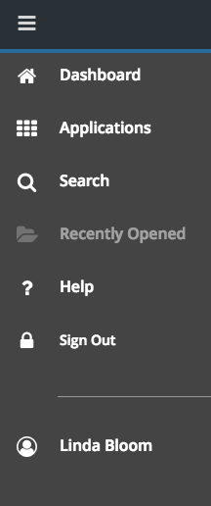
Application Navigator Access Banner Administrative Applications
Menu – List all options
Dashboard – Back to homepage
Applications – List of Banner pages (forms) by department/access
Search – Multiple options
Recently Opened – Listing of specific pages that have been visited
Help
Sign Out – sign out after each session. Since web-based if don’t sign out can cause ‘browser’ history and issues logging back in
User Name
Profile – Customize display
Notes:
Application Navigator – is the landing page and home link.
Menu icon (CTRL+M) – The Menu icon is located in the upper left corner of the application. Click on this icon to open the Banner Menu. Find the page you are interested in opening. Select the desired entry and click Enter. The Menu icon will also allow you to open the My Banner menu which will allow you to create a personal list of pages that you use regularly. See the appendix for directions regarding how to set up My Banner.
Search icon (CTRL+Shift+Y) – The Search icon is located in the upper left corner, just to the right of the Menu icon. Click on this icon to open the Search window. You can then enter either the descriptive name of the page or the Banner acronym for the page.
Recently Opened icon (CTRL+Y) – The Recently Opened icon is located in the upper left corner, just to the right of the Search icon. It is displayed with a count of pages after you have opened the first page in an application. Open the list and select a page to access it.
Search box in the center of the page (CTRL+Home) – In this box, you can enter either the descriptive name of the page or the Banner acronym for the page. Find the desired entry and click Enter.

Slide 7
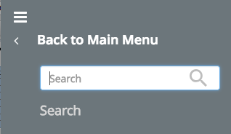
Application Navigator Access Banner Administrative Applications
Notes:
Application Navigator – is the landing page and home link.
Menu icon (CTRL+M) – The Menu icon is located in the upper left corner of the application. Click on this icon to open the Banner Menu. Find the page you are interested in opening. Select the desired entry and click Enter. The Menu icon will also allow you to open the My Banner menu which will allow you to create a personal list of pages that you use regularly. See the appendix for directions regarding how to set up My Banner.
Search icon (CTRL+Shift+Y) – The Search icon is located in the upper left corner, just to the right of the Menu icon. Click on this icon to open the Search window. You can then enter either the descriptive name of the page or the Banner acronym for the page.
Recently Opened icon (CTRL+Y) – The Recently Opened icon is located in the upper left corner, just to the right of the Search icon. It is displayed with a count of pages after you have opened the first page in an application. Open the list and select a page to access it.
Search box in the center of the page (CTRL+Home) – In this box, you can enter either the descriptive name of the page or the Banner acronym for the page. Find the desired entry and click Enter.

Slide 8
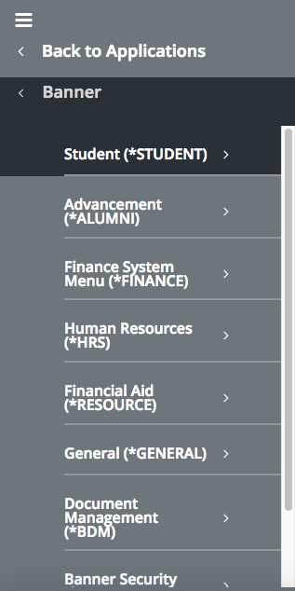
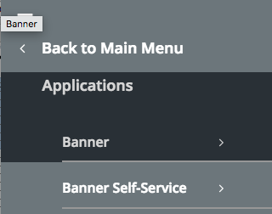
Application Navigator Access Banner Administrative Applications
Notes:
Application Navigator – is the landing page and home link.
Menu icon (CTRL+M) – The Menu icon is located in the upper left corner of the application. Click on this icon to open the Banner Menu. Find the page you are interested in opening. Select the desired entry and click Enter. The Menu icon will also allow you to open the My Banner menu which will allow you to create a personal list of pages that you use regularly. See the appendix for directions regarding how to set up My Banner.
Search icon (CTRL+Shift+Y) – The Search icon is located in the upper left corner, just to the right of the Menu icon. Click on this icon to open the Search window. You can then enter either the descriptive name of the page or the Banner acronym for the page.
Recently Opened icon (CTRL+Y) – The Recently Opened icon is located in the upper left corner, just to the right of the Search icon. It is displayed with a count of pages after you have opened the first page in an application. Open the list and select a page to access it.
Search box in the center of the page (CTRL+Home) – In this box, you can enter either the descriptive name of the page or the Banner acronym for the page. Find the desired entry and click Enter.

Slide 9
Application Navigator Basic Navigation: Page Header, Key Block, Section Notification, Buttons
The first key block (most pages) contains key information - what data is entered determines viewing. This block stays on the page as other sections are displayed.
When the cursor is in the key block, the fields that can be entered are enabled. When leave the key block, the fields are disabled.
When the cursor is in the key block, the information is displayed in a column format. When leave the key block by clicking the Go (previously Next Block) button, the data is rearranged into a linear format and not enterable.
To access the body of the page, populate the key block data and then click Go. Return to the key block in the body of a page by clicking Start Over (previously Rollback).
Notes:
Application Navigator – is the landing page and home link.
Menu icon (CTRL+M) – The Menu icon is located in the upper left corner of the application. Click on this icon to open the Banner Menu. Find the page you are interested in opening. Select the desired entry and click Enter. The Menu icon will also allow you to open the My Banner menu which will allow you to create a personal list of pages that you use regularly. See the appendix for directions regarding how to set up My Banner.
Search icon (CTRL+Shift+Y) – The Search icon is located in the upper left corner, just to the right of the Menu icon. Click on this icon to open the Search window. You can then enter either the descriptive name of the page or the Banner acronym for the page.
Recently Opened icon (CTRL+Y) – The Recently Opened icon is located in the upper left corner, just to the right of the Search icon. It is displayed with a count of pages after you have opened the first page in an application. Open the list and select a page to access it.
Search box in the center of the page (CTRL+Home) – In this box, you can enter either the descriptive name of the page or the Banner acronym for the page. Find the desired entry and click Enter.

Slide 10
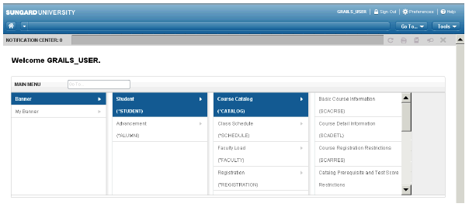
Main Menu Choose which modules, pages, etc.
Emerson College
Menu can be customized for department areas.
Notes:
Terminology has changed:
Forms = Pages
Key and Next Blocks = Go
Blocks = Sections
Rollback = Start Over
Query = Filter
Page Header
• Page Title as controlled by GUAUPRF
• Actions include: Page Close, Workflow Release and Submit, BDM Add and Retrieve, Related Menu, Tools Menu, and Notification Center
Key Block
• When in the Key Block, the fields are displayed in columns and are
enterable. When out of the Key Block, the fields are rearranged into a
linear format and are not enterable.
Sections
• If a page has multiple sections, they can be expanded or collapsed
• Header actions include: Multiple Record, Insert, Delete, Copy, Filter, and SDE More Information

Slide 11
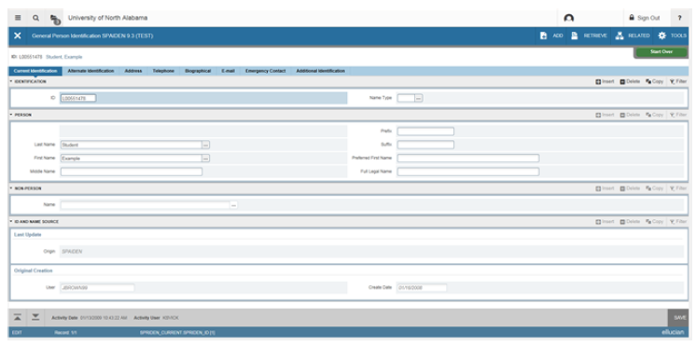
Application Navigator Basic Navigation: Page Header, Key Block, Section Notification, Buttons
Notes:
Application Navigator – is the landing page and home link.
Menu icon (CTRL+M) – The Menu icon is located in the upper left corner of the application. Click on this icon to open the Banner Menu. Find the page you are interested in opening. Select the desired entry and click Enter. The Menu icon will also allow you to open the My Banner menu which will allow you to create a personal list of pages that you use regularly. See the appendix for directions regarding how to set up My Banner.
Search icon (CTRL+Shift+Y) – The Search icon is located in the upper left corner, just to the right of the Menu icon. Click on this icon to open the Search window. You can then enter either the descriptive name of the page or the Banner acronym for the page.
Recently Opened icon (CTRL+Y) – The Recently Opened icon is located in the upper left corner, just to the right of the Search icon. It is displayed with a count of pages after you have opened the first page in an application. Open the list and select a page to access it.
Search box in the center of the page (CTRL+Home) – In this box, you can enter either the descriptive name of the page or the Banner acronym for the page. Find the desired entry and click Enter.

Slide 12
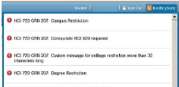
Notification Center & Help Information/Communication Displayed
Green = Successful Save
Yellow = Warning Msg.
Blue = Informational Msg.
Red = Error Msg.
Errors are displayed in red & affiliated with the field/record error
Notes:
Terminology has changed:
Forms = Pages
Key and Next Blocks = Go
Blocks = Sections
Rollback = Start Over
Query = Filter
Page Header
• Page Title as controlled by GUAUPRF
• Actions include: Page Close, Workflow Release and Submit, BDM Add and Retrieve, Related Menu, Tools Menu, and Notification Center
Key Block
• When in the Key Block, the fields are displayed in columns and are
enterable. When out of the Key Block, the fields are rearranged into a
linear format and are not enterable.
Sections
• If a page has multiple sections, they can be expanded or collapsed
• Header actions include: Multiple Record, Insert, Delete, Copy, Filter, and SDE More Information

Slide 13
Notification Center & Help Information/Communication Displayed
• Ctrl+Shift+L: Online Help - top right corner
• In online help, use the upper left menu button to access the Contents or Search Tabs.
• Help (Item Properties) available from Tools (Alt+Shift+T)
• Use to identify a table/field name for writing reports or troubleshooting.
• Data Block = Table
Physical Name = Field
Notes:
Terminology has changed:
Forms = Pages
Key and Next Blocks = Go
Blocks = Sections
Rollback = Start Over
Query = Filter
Page Header
• Page Title as controlled by GUAUPRF
• Actions include: Page Close, Workflow Release and Submit, BDM Add and Retrieve, Related Menu, Tools Menu, and Notification Center
Key Block
• When in the Key Block, the fields are displayed in columns and are
enterable. When out of the Key Block, the fields are rearranged into a
linear format and are not enterable.
Sections
• If a page has multiple sections, they can be expanded or collapsed
• Header actions include: Multiple Record, Insert, Delete, Copy, Filter, and SDE More Information

Slide 14
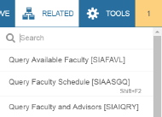
Tools, Related & Exit
Tools
Similar to the Options Menu for data actions
Related
Similar to Options menu for pages (forms)
Exit
Saving changes
If don’t exit may have difficulty on next entry

Slide 15
Increased Accessibility & Customization
Accessibility Mode: change navigation pattern and more buttons accessible to screen readers
Improved Visibility: Settings can be adjusted to accommodate user.

Slide 16
myBanner
Create a personal menu tied to your Banner user ID
Contains the pages, jobs, menus, and Quickflows that are most important in your daily work.
Once created, access from the main menu.

Slide 17
My Banner
From Application Navigator page, in search box enter either ‘MyBanner’ or GUAPMNU

Slide 18
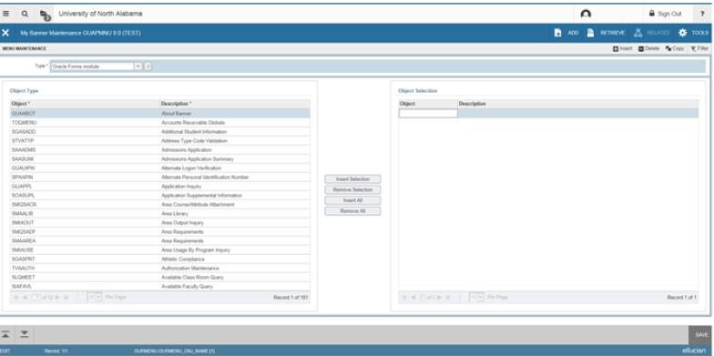
My Banner Maintenance Page
Type: A drop down menu allows you to choose from Forms (pages) , Job Submissions, Menus, Messages, and Workflows - all forms to customize.
Object Type: All available pages, jobs, menus, or quickflows associated with the chosen type selected from the drop down menu.
Buttons: Used to insert/remove selections from the available list.
Object Selection: Will display the contents of your personal menu.

Slide 19
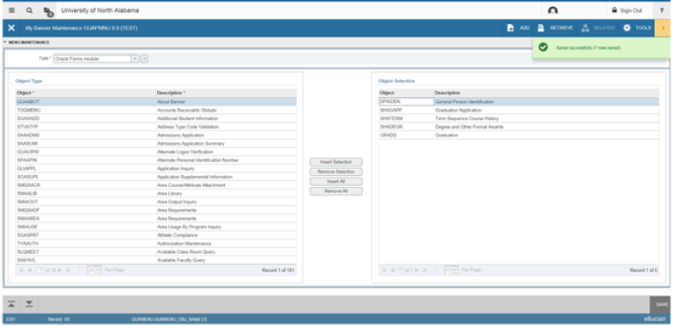
My Banner Maintenance Page
Add objects - select the name from the left pane by double clicking it and then use the Insert buttons to add to the right pane.
After each page selection to the right pane, select Save in the bottom right hand corner to retain selections.

Slide 20
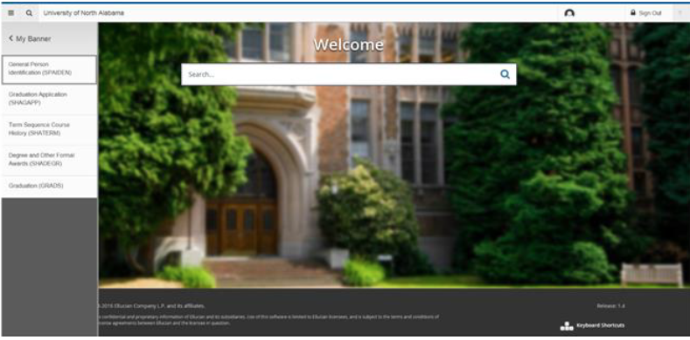
My Banner Maintenance Page
You will have to sign out and back in to see changes on your My Banner.
Remember to select Save before exiting the page.

Slide 21
Advanced Features Preparing for Academic Future
‘Tools’ – extended menu linking to other software applications
Related Items – Output

Slide 22
Advanced Features Preparing for Academic Future
Large-scale upgrade
Evolutionary Technology - Appropriate skill-set? Training?
Restructuring academic programs – based on additional options
Changing your culture by building a connected campus
Planning a ‘smooth’ cloud migration
Report/data generating – financial aid audits
Streamline Operations
Enabling Student Success – DegreeWorks
Where do we go from here?

Slide 23
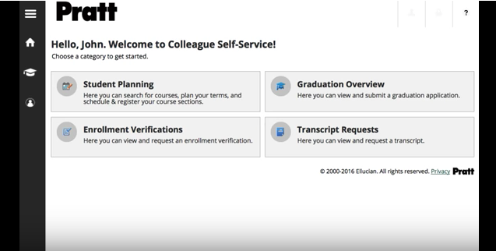
DegreeWorks
Hello, John. Welcome to Student Self-Service!

Slide 24
What is the one thing you have to do?

